Slide 1
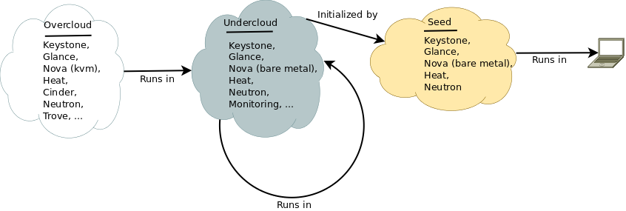

Slide 2
Lifecycle
Bootstrap
Discover
Enroll
Deploy Undercloud
Deploy Overcloud
Decommission

Slide 3
Bootstrap
Disk-image-builder
KVM
TripleO-Incubator
Creates Seed Cloud

Slide 4
Discover
No tooling present
An opt-in service would be great, possibly part of Ironic, possibly stand-alone
Already inventoried environments (most datacentres) do not need discovery.

Slide 5
Enroll
Register machines with nova-baremetal API
In future, setup aggregates to identify common failure domains for anti-affinity scheduling
Uses:
  Nova-baremetal
  Keystone

Slide 6
Deploy Under Cloud
Deploy single node control plane using Seed Cloud
Migrate ownership from Seed into Under Cloud
Scale out to desired level – HA, expected load, desired deploy performance
Configure admin users, monitoring, CMDB, other non-core services
Uses the seed and undercloud:
  Nova-baremetal
  Keystone
  Glance
  Neutron
  Heat

Slide 7
Deploy Over Cloud
Deploy full scale cluster as desired - HA, expected load, desired performance/availability tradeoffs
Configure admin users, monitoring, CMDB, other non-core services
Uses the undercloud:
  Nova-baremetal
  Keystone
  Glance
  Neutron
  Heat

Slide 8
Decommission
Boot a disk wipe utility on all machines except control plane
Unenroll all wiped machine
Scale control plane down to one machine
Automatically wipe all remaining unused machines
Wipe the final control plane by hand
Uses:
  Nova-bm
  Heat
  Keystone
  Glance
  Neutron

